Slide 1
Visual Processing for Social Media
Andrew C. Gallagher
Tsuhan Chen
September 30, 2012
Cornell University
TexPoint fonts used in EMF.
Read the TexPoint manual before you delete this box.: AAAA

Slide 2
What is Social Media?
Social media is created by users for users.
video
images
audio
text
TexPoint fonts used in EMF.
Read the TexPoint manual before you delete this box.: AAAA

Slide 3
What is Visual Processing?
Visual Processing extracts information from pictures and video.
TexPoint fonts used in EMF.
Read the TexPoint manual before you delete this box.: AAAA

Slide 4
How it fits together
What we know about people
Social Images
Notes:
Fir the

Slide 5
Outline
Social Media Overview
Visual Processing Overview
Social Media Insights Within the Image
Social Media Insights From Sharing
TexPoint fonts used in EMF.
Read the TexPoint manual before you delete this box.: AAAA

Slide 6
Outline
Social Media Overview
Visual Processing Overview
Social Media Insights Within the Image
Social Media Insights From Sharing
TexPoint fonts used in EMF.
Read the TexPoint manual before you delete this box.: AAAA

Slide 7
Media has always been social
13000-15000 BC, Lascaux, France
TexPoint fonts used in EMF.
Read the TexPoint manual before you delete this box.: AAAA
Notes:
Why do we have images? Telling stories, recording events.
These slides show how the accuracy of depiction scenes improves over time, how the process becomes easier, and how it becomes a consumer process…

Slide 8
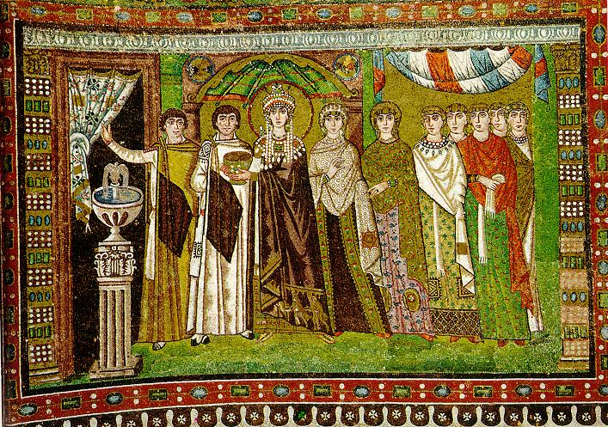
Middle Ages
The Empress Theodora with her court.
Ravenna, St. Vitale 6th c.
Slide by Alexei Efros, CMU

Slide 9
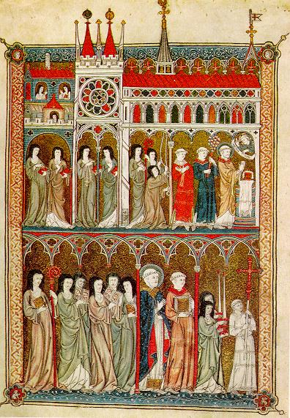
Middle Ages
Nuns in Procession. French ms. ca. 1300.
Slide by Alexei Efros, CMU

Slide 10
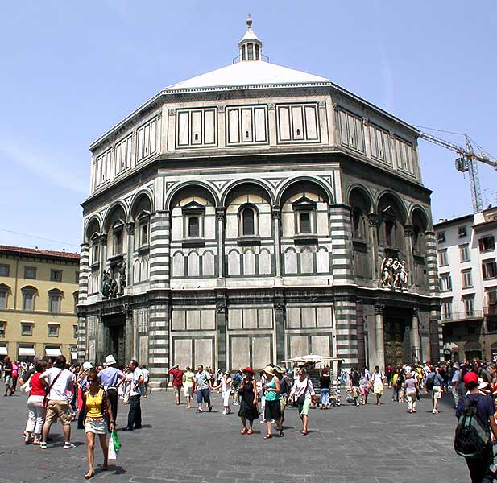
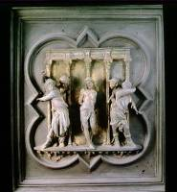
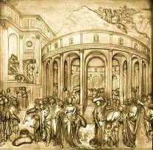
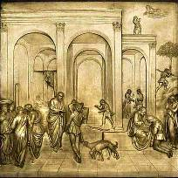
Renaissance
Slide by Alexei Efros, CMU
North Doors (1424)
East Doors (1452)
Lorenzo
Ghiberti
(1378-1455)

Slide 11
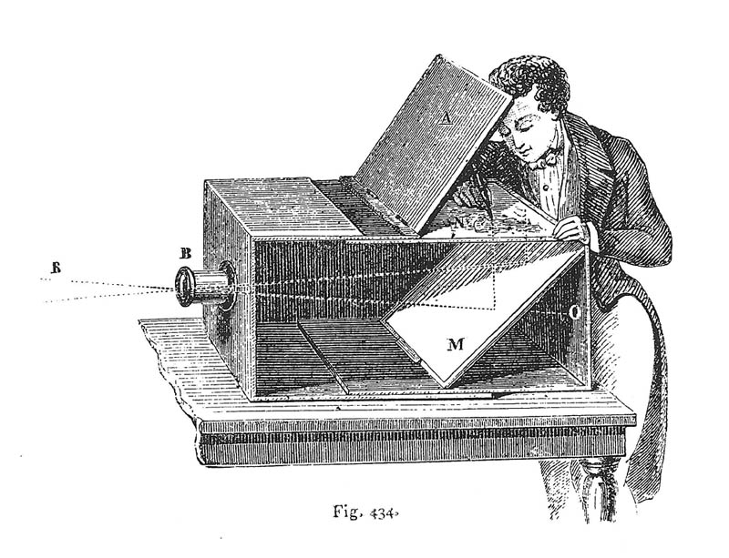
Toward Automation
Lens Based Camera Obscura, 1568
Slide by Alexei Efros, CMU

Slide 12
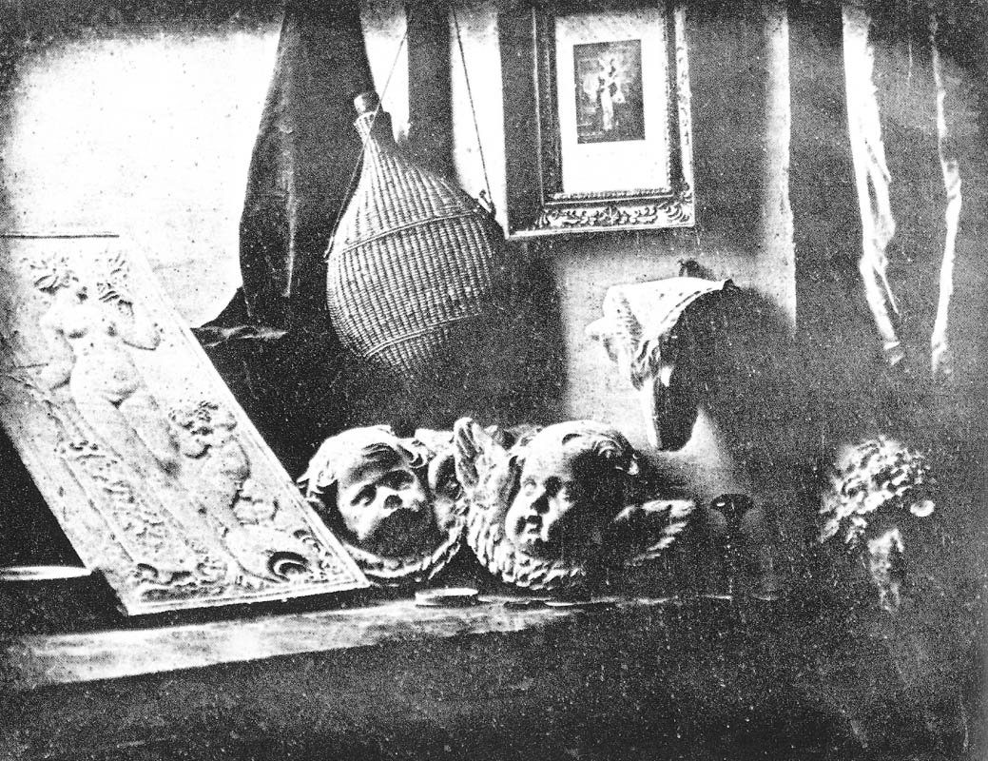
Removing the Artist
Still Life, Louis Jaques Mande Daguerre, 1837
Slide by Alexei Efros, CMU
Notes:
First photograph: 1825, Daguerrotpye

Slide 13
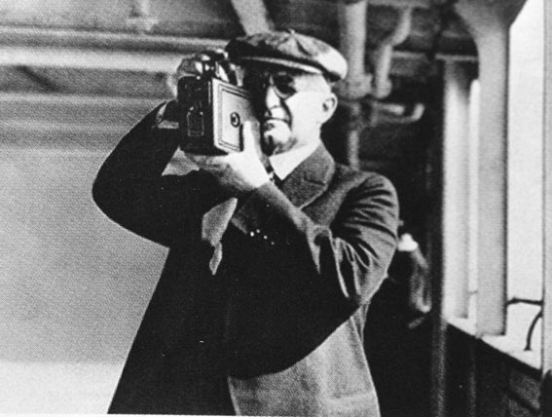
Media for the masses
George Eastman with the Kodak Camera, introduced 1888
TexPoint fonts used in EMF.
Read the TexPoint manual before you delete this box.: AAAA
Notes:
George Eastman made it so everyone could capture snapshots. The Kodak camera was introduced in

Slide 14
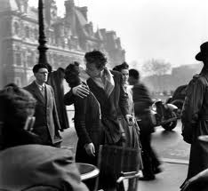
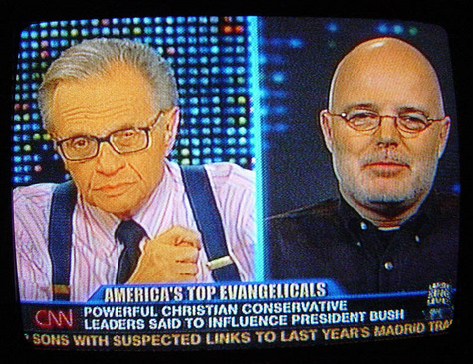
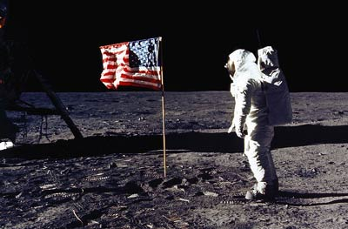
Mass Media
Slide by Alexei Efros, CMU
Notes:
Images and videos now are broadcast to thousands and millions, but generally by a centralized media

Slide 15
Personal Media
Photo by Flickr user by saikofish: http://www.flickr.com/photos/lou/197198984/
Notes:
And, there were millions of images being viewed by small audiences.

Slide 16
Social Media until Web 2.0
Audience (viewing public)
Content creators
Mass Media
Content creators (consumer cameras)
Audience (friends/family)
Personal Media
Notes:
And, there were millions of images being viewed by small audiences.

Slide 17
Social Media Now
Twitter: 67M users
Top Accounts have > 25M followers
Facebook: 955M users
Median user has about 100 friends
Two people are separated by 4.7 ‘degrees’
YouTube:
72 hours of video uploaded each minute
10 years of video are watched each minute
In 2011, over 1T page views
http://www.youtube.com/t/press_statistics
http://arxiv.org/pdf/1111.4570v3.pdf
http://twittercounter.com/
http://pdf.secdatabase.com/700/0001193125-12-316895.pdf

Slide 18
Social Media Now vs. Then
Then:
small audiences or small numbers of content creators
Now:
Everyone is an author
Then: Time delay is common
Now: Nearly real-time sharing
Notes:
And, there were millions of images being viewed by small audiences.

Slide 19
Social Media for Data Mining
What we know about people
Social Media

Slide 20
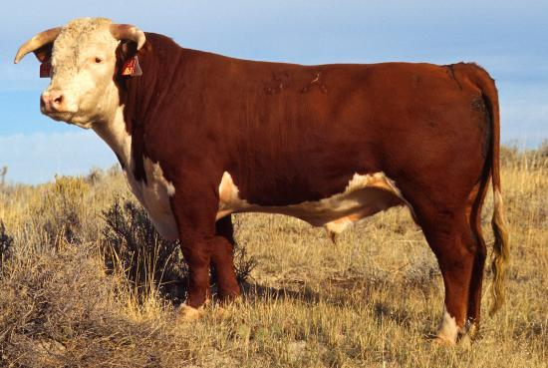
Wisdom of the Crowds
(James Surowiecki’s 2005): under the right conditions, a crowd of non-experts can lead to decisions that are even smarter than the experts within the crowd

Slide 21
Live Demo!
http://tinyurl.com/8jm5qky

Slide 22
Live Demo! (M&Ms)
http://tinyurl.com/8gssdv9

Slide 23
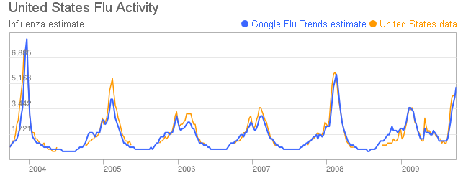
Google Flu Trends
(Ginsberg et al., Nature, 2009)
Notes:
Advantages: Faster than CDC!

Slide 24
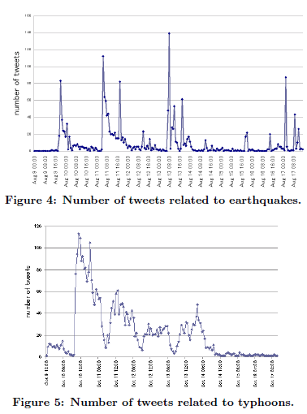
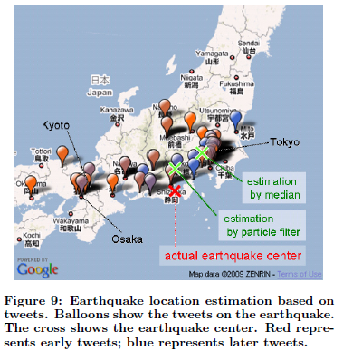
Earthquake Sensing
(Earthquake Shakes Twitter Users, Sakaki et al., WWW 2010)

Slide 25
Information in Social Media

Slide 26
Information in Social Media
Time of capture/upload
Camera make/model and settings
Geo-location
Tags of persons/objects
Comments/Likes/Views
Interestingness
Pixel Values

Slide 27
What Questions can Social Media Help Answer?
What is in the picture?
Where was a video captured?
What candidate will win the election?
How many iPhones have been sold?
What people were at the event?
What book should I buy?
What should I name my baby?
…

Slide 28
Outline
Social Media Overview
Visual Processing Overview
Social Media Insights Within the Image
Social Media Insights From Sharing
TexPoint fonts used in EMF.
Read the TexPoint manual before you delete this box.: AAAA

