Slide 1

Recovering Depth of a Dynamic Scene Using Real World Motion Prior
Adarsh Kowdle Noah Snavely Tsuhan Chen
Cornell University

Slide 2
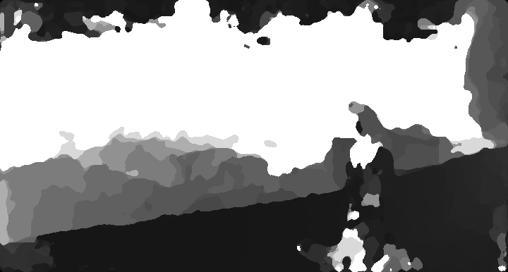
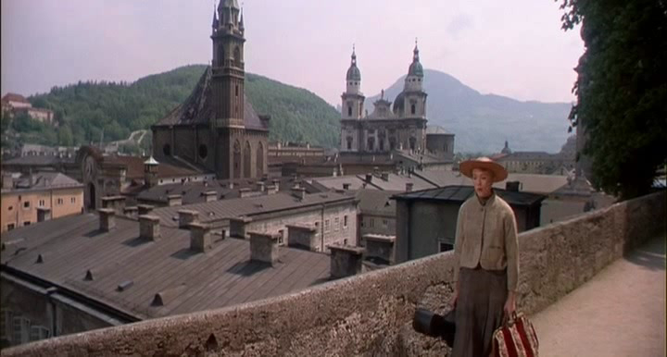
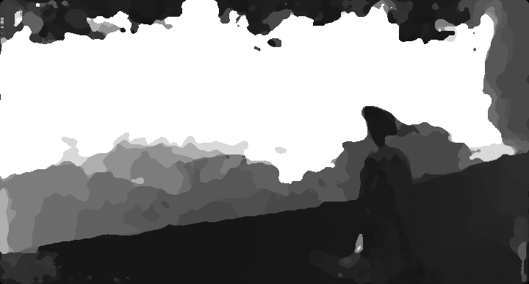
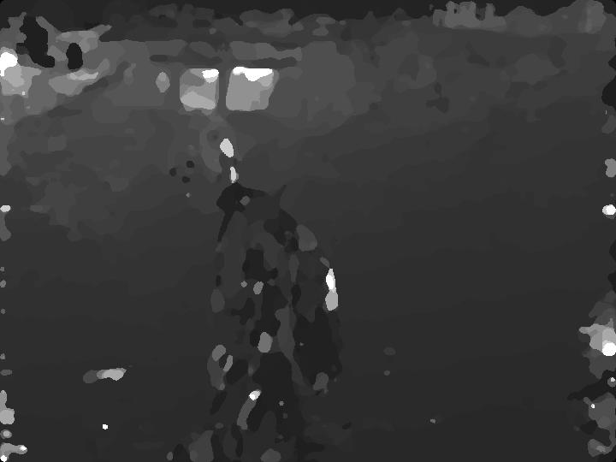
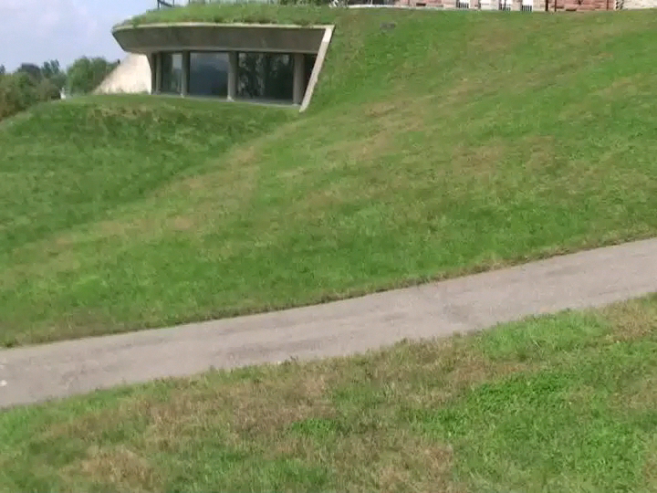
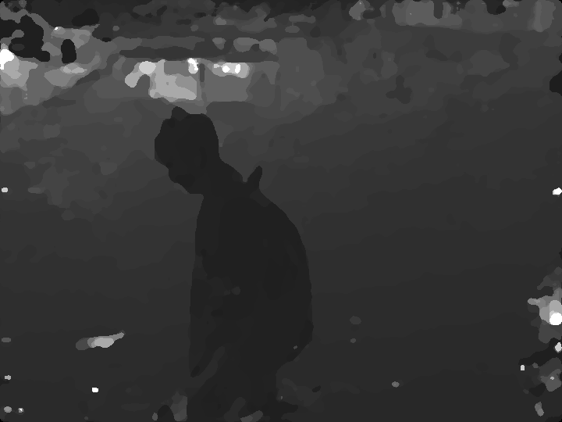

Slide 3
Prior work on dense depth estimation using monocular videos
Mainly in the regime of static scene
Pollefeys et. al. IJCV ’08; Gallup et. al. CVPR ’10;
Furukawa et. al. CVPR ‘10
Zhang et. al. PAMI ‘09, ‘11
Okutomi et. al. PAMI ’03; Seitz et. al. CVPR ‘06
Recover depth of a dynamic scene by incorporating the moving object
into a standard plane sweep stereo framework

Slide 4
Recovering Depth of a Dynamic Scene
x
x
x

Slide 5
Recovering Depth of a Dynamic Scene
x
x
x

Slide 6
Proposed algorithm
x
x
x

Slide 7
Algorithm overview
Initial depthmaps using plane sweep stereo assuming static scene
User helps identify the region corresponding to the moving object
Incorporate real world motion prior and occlusions to obtain depth bounds
Obtain refined depthmap incorporating object motion into original plane sweep stereo

Slide 8
Plane sweep stereo
Assumption:
  Cameras see enough static background to calibrate the cameras even in the presence of the moving object
Structure-from-motion (Bundler by Snavely et. al.)
  Camera calibration and a sparse 3D point cloud reconstruction
Standard plane sweep stereo
  100 fronto-parallel 3D planes uniformly sampled in disparity space or inverse depth (bounds obtained from 3D point cloud)
  Error metric for the cost cube – Normalized Cross Correlation
100
h
w

Slide 9
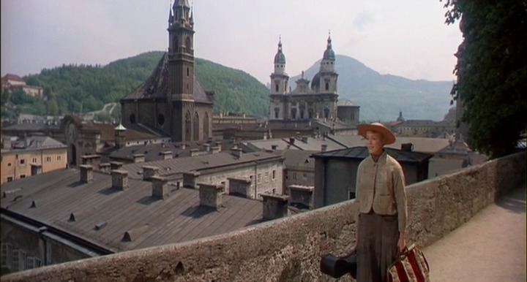
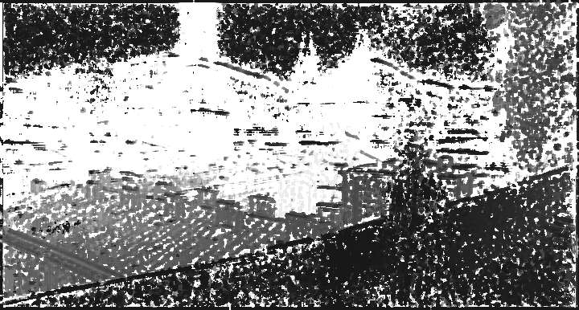

Pixel level maximize NCC
100
h
w
Guided filter
He et.al. ECCV 2010
Rhemann et.al. CVPR 2011
Pixel level maximize NCC on filtered Cost Cube

Slide 10
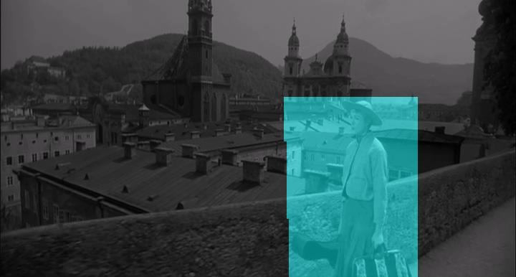
Moving object identification
User bounding box tracked using the optical flow
Other interactive co-segmentation works could also be used

Slide 11
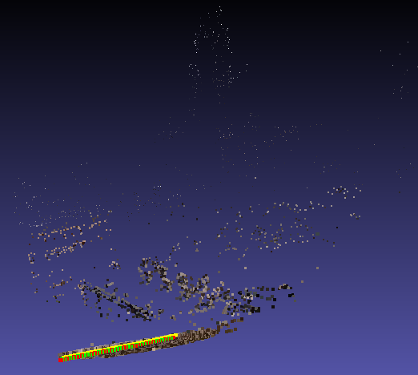

Depth bound using occluding regions
Structure-from-motion
3D point cloud

Slide 12
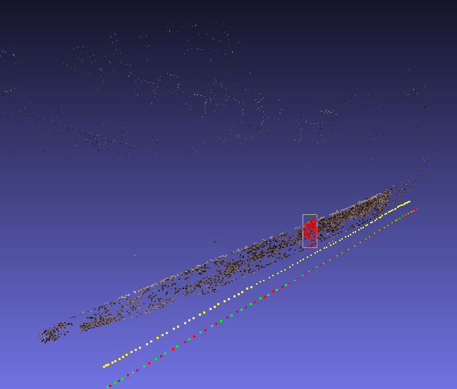
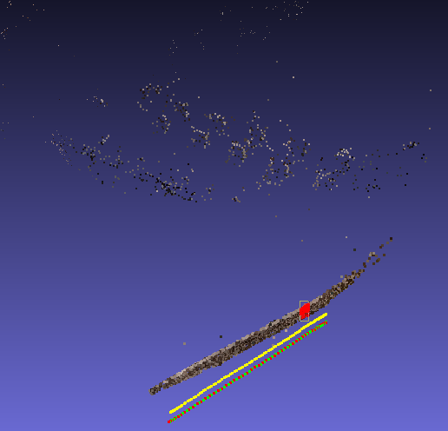
Depth bound using occluding regions

Slide 13
Depth bounds for the moving object
x
x
x
Upper bound on depth using object occlusions

Slide 14
Depth bounds for the moving object
x
x
x

Slide 15
Depth bounds for the moving object
Lower bound on depth using the speed of the object
x
x
x
Upper bound on depth using object occlusions

Slide 16
Temporally smooth trajectory

Slide 17
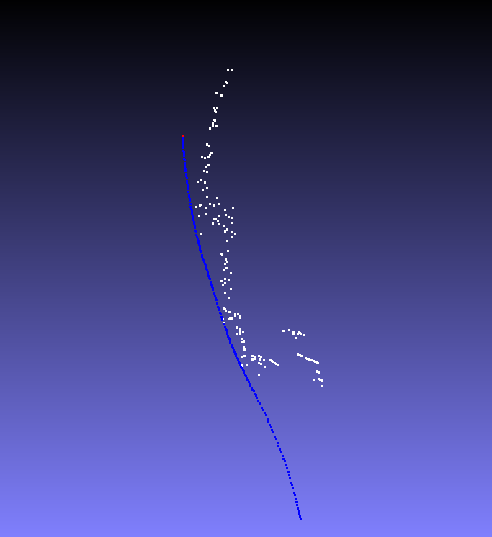
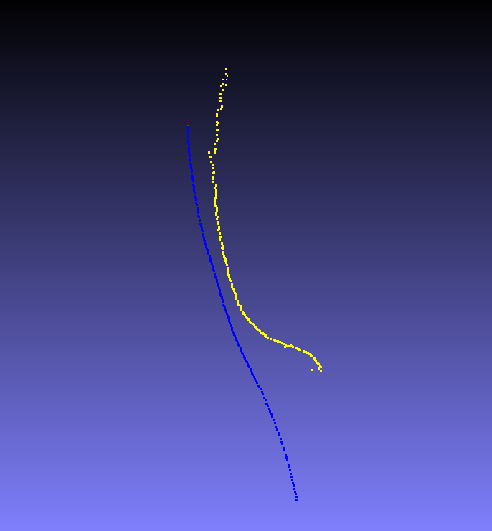
Before
Smooth 3D trajectory

Slide 18

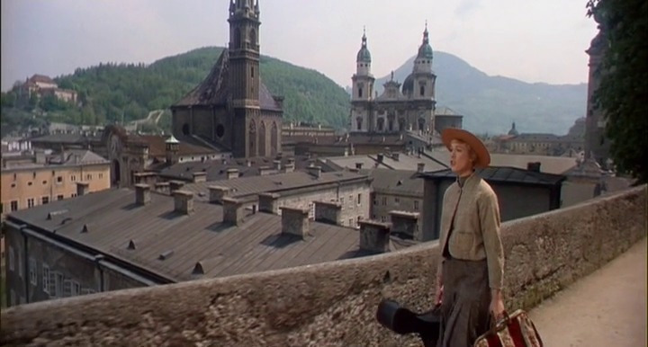
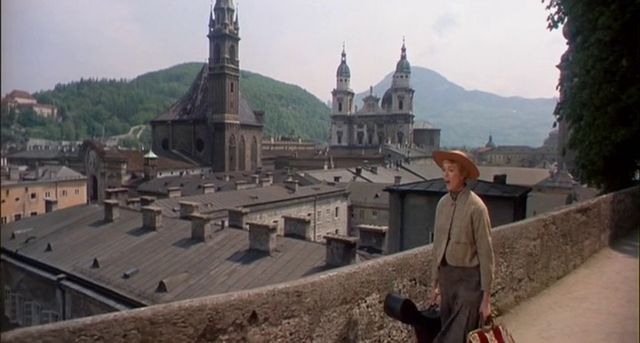
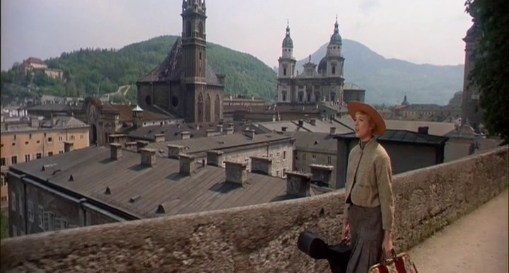
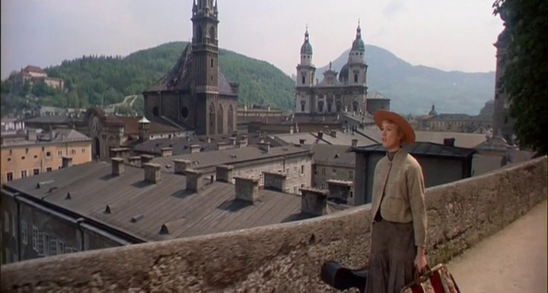
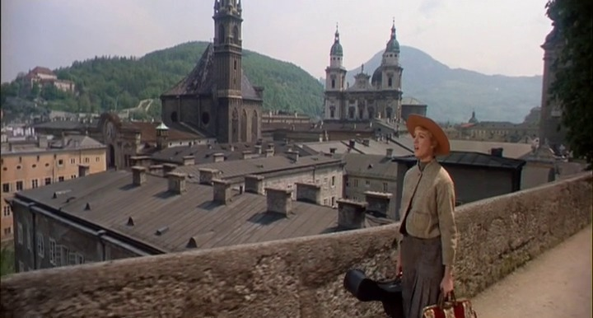
Qualitative results

Slide 19
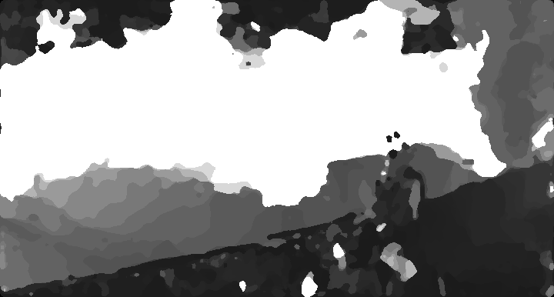
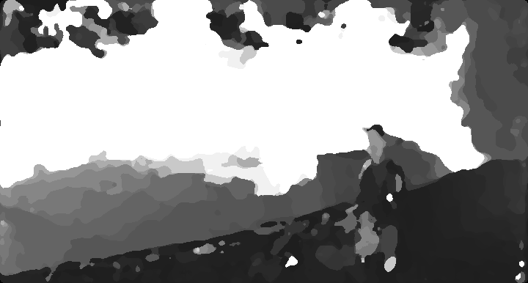
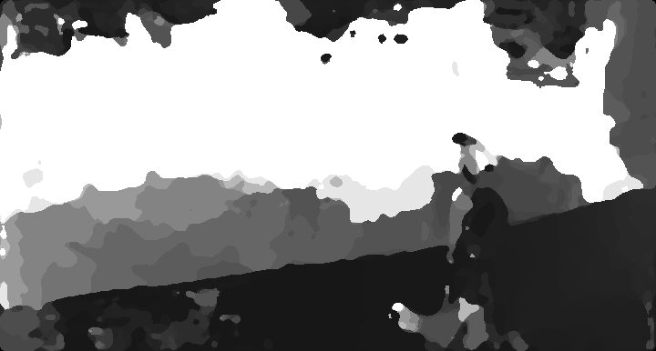
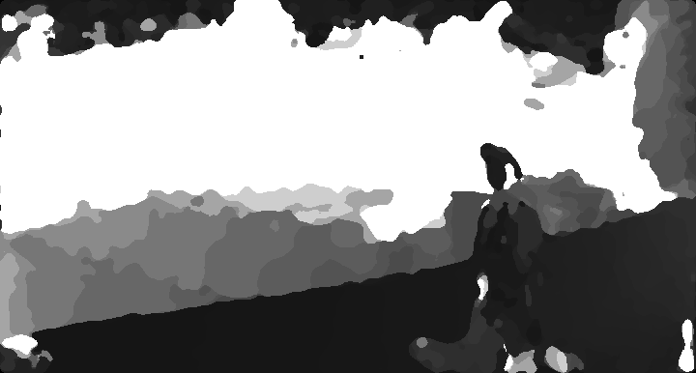
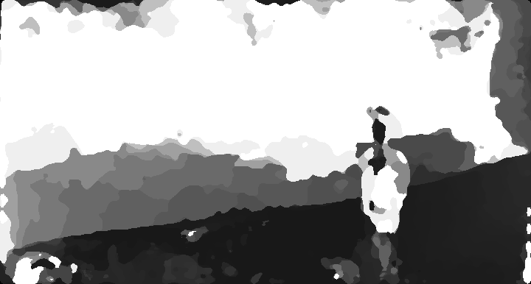
Initial depthmaps

Slide 20


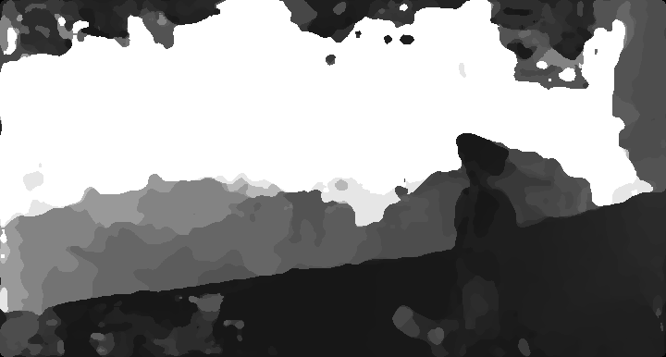
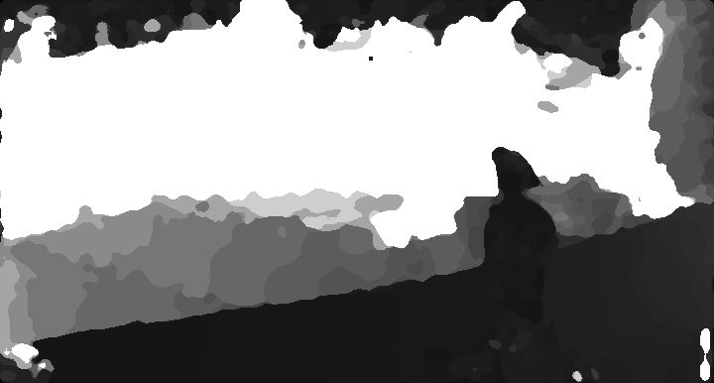

After incorporating object motion

Slide 21
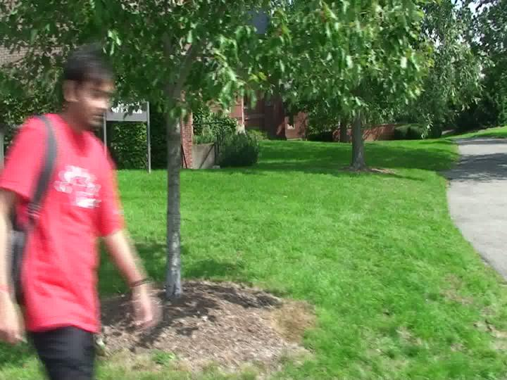
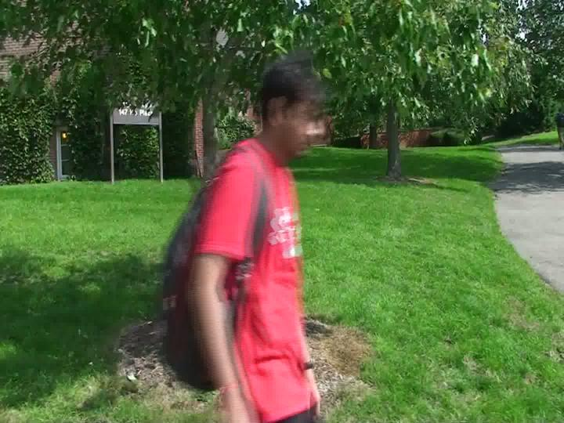
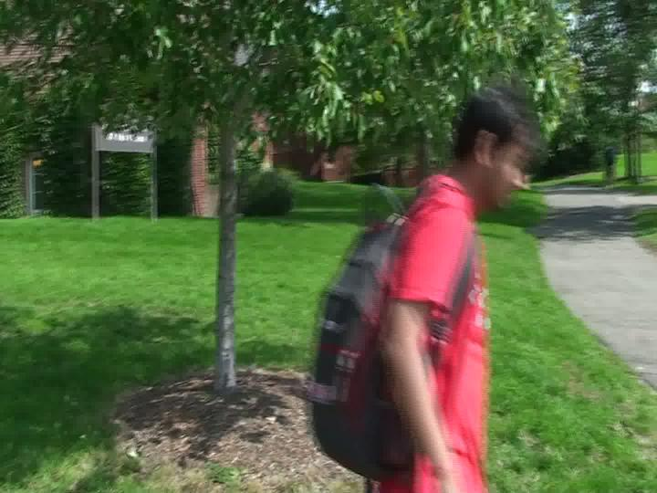
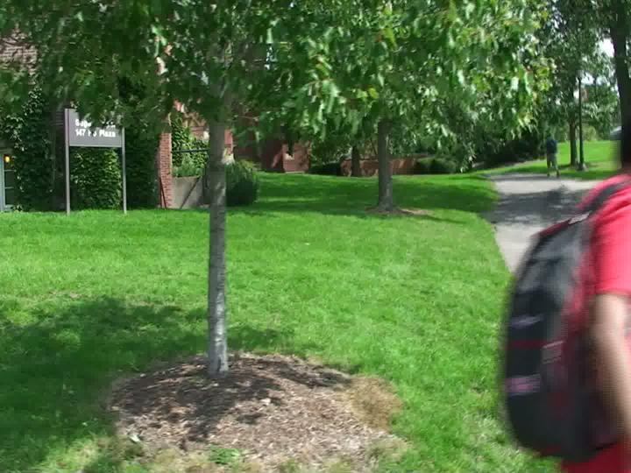
Qualitative results

Slide 22




Initial depthmaps

Slide 23

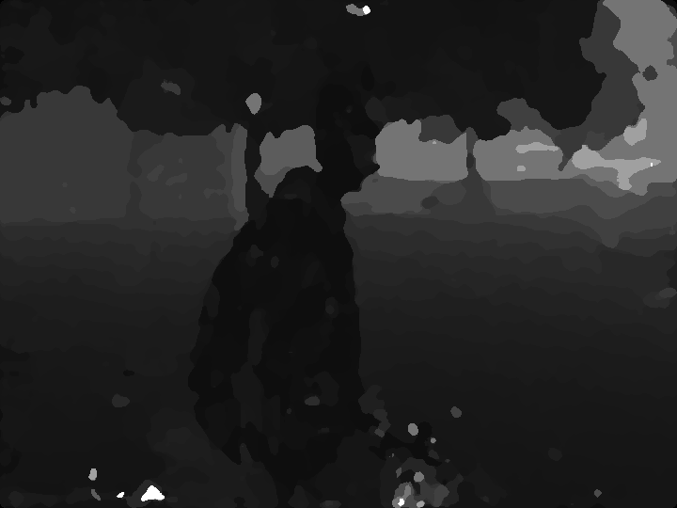


After incorporating object motion

Slide 24
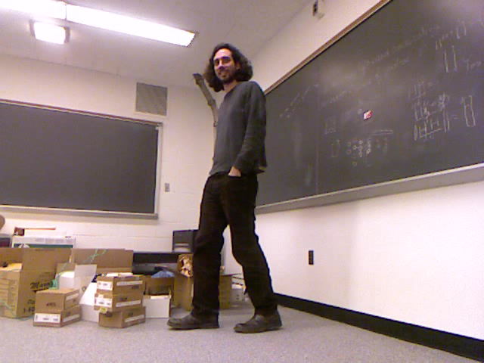
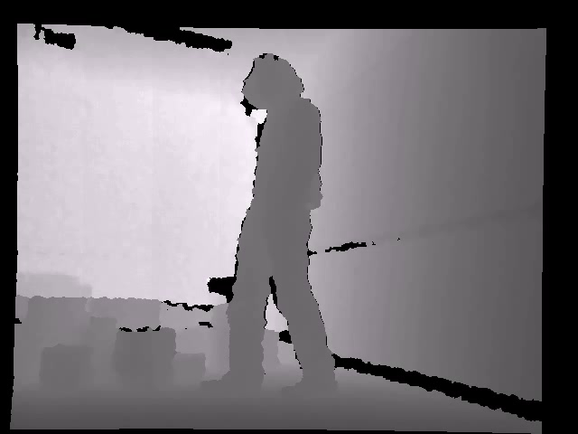
Quantitative results
Average performance across 5 videos with about 50 frames each
Ground truth using an RGBD camera

Slide 25
Quantitative results
Error computed for pixels corresponding to the moving object
Initial depthmap
Proposed approach

Slide 26
Conclusion and future work
We propose an approach to estimate the depth of a dynamic scene captured using a dynamic camera
  Depth bounds using occlusions and motion prior
  Can be integrated into existing state-of-art approaches
    post-process the depthmap with plane fitting and semantics (sky detection)
Relaxing the current assumption of the speed of the object via semantics
    Object recognition – people vs. automobiles
    Ground surface contact point identification

Slide 27
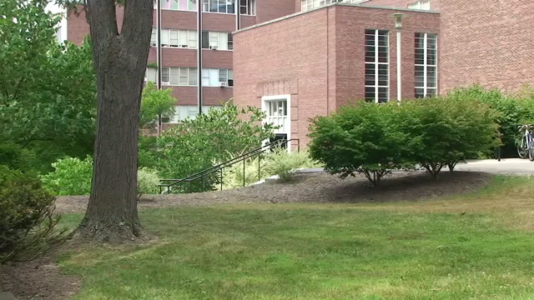

Conclusion and future work
Turning the table around
Moving object can help recover depth of the scene

Slide 28
Recovering Depth of a Dynamic Scene Using
Real World Motion Prior
Thank You
Lower bound on depth using the speed of the object
x
x
x
Upper bound on depth using object occlusions
Adarsh Kowdle Noah Snavely Tsuhan Chen
Cornell University

Slide 30
Plane sweep stereo
O_{nei1}
x
O_{ref}
x
O_{nei2}
x

Slide 31
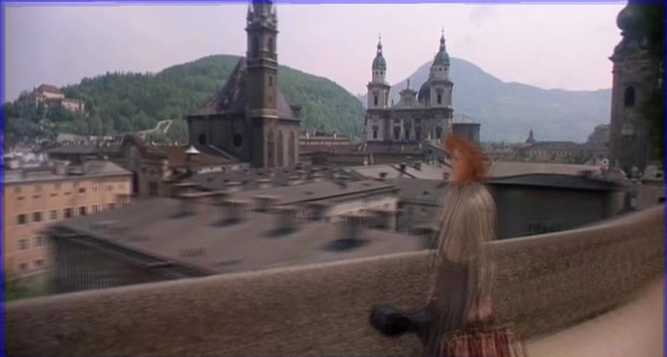
Plane sweep stereo

Slide 32
Depth from videos of dynamic scenes
3D trajectory of the moving object
  Temporally smooth trajectory

Slide 33
Depth from videos of dynamic scenes
3D trajectory of the moving object
  Temporally smooth trajectory
    For each frame,
    X: Features [camera centers and 3D ray through object centroid]
    Y: Estimated depths along the ray
    w: Regression parameters
      L-1 sparsity helps void over-fitting due to noisy data

Slide 34
Depth from videos of dynamic scenes
3D trajectory of the moving object
  Non-linear fit: Polynomial kernel
    d: degree of the polynomial (smooth motion)
    k: dimension of X
  MDL principle: choose d to maximize posterior

Slide 35
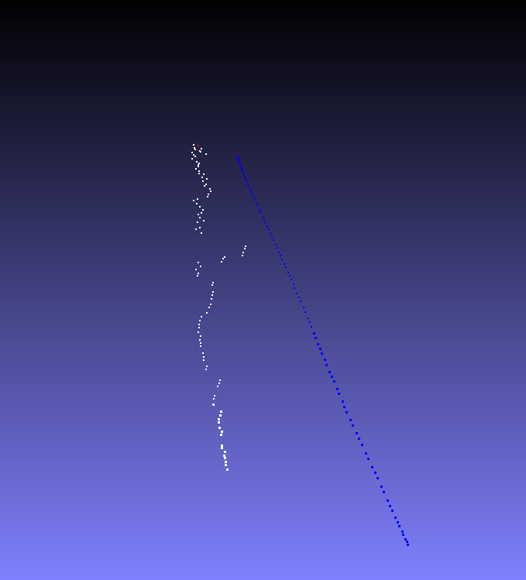
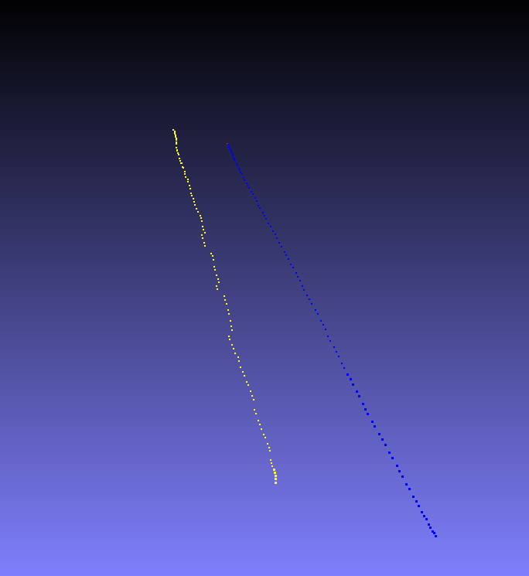
Depth from videos of dynamic scenes
Before
Smooth 3D trajectory

Slide 36
Depth from videos of dynamic scenes
Before
Smooth 3D trajectory

Slide 37
Depth from videos of dynamic scenes
3D trajectory of the moving object
  Constrained quadratic program
    Hard constraints from ground contact point detection
    Additional user inputs as constraints
s.t.

Slide 38
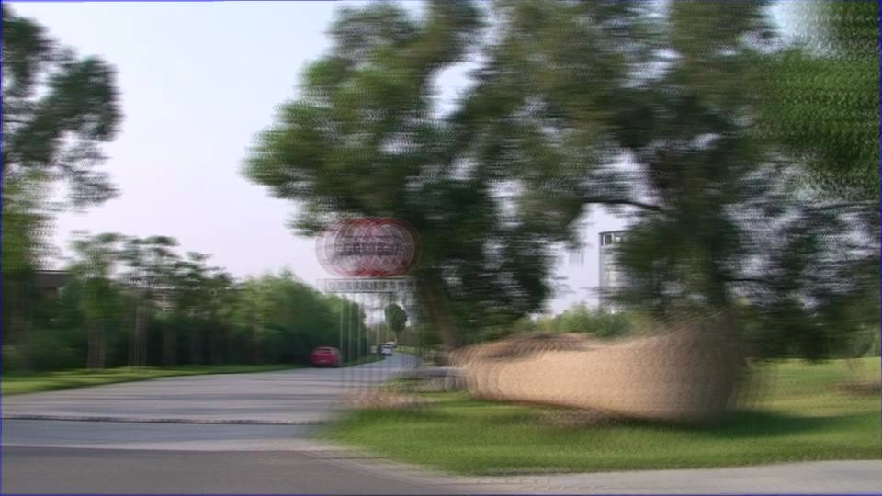
Plane sweep stereo

