Slide 1
i3D: Interactive Planar Reconstruction of Objects and Scenes
Adarsh Kowdle Yao-Jen Chang
Tsuhan Chen
School of Electrical and Computer Engineering
Cornell University
WNYIP 2009
09/25/2009

Slide 2
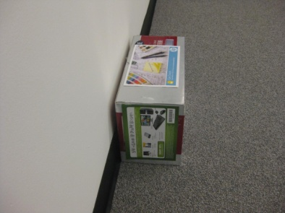
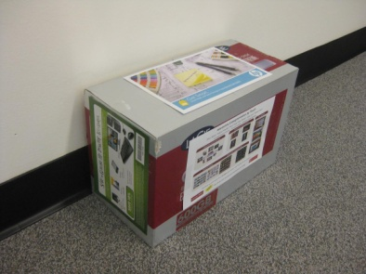
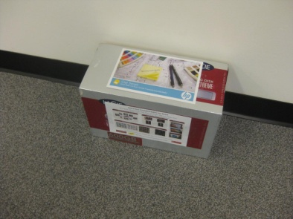
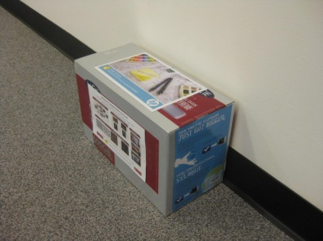
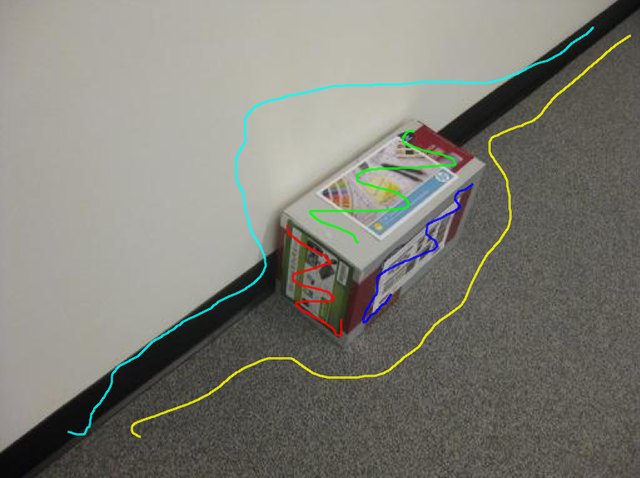
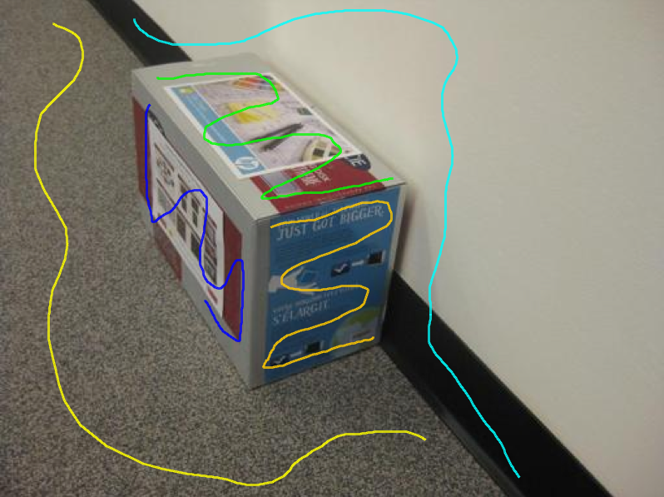
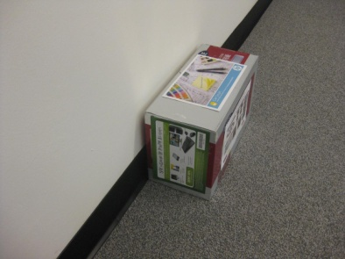
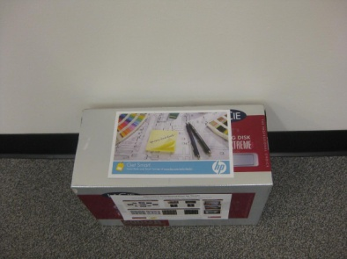
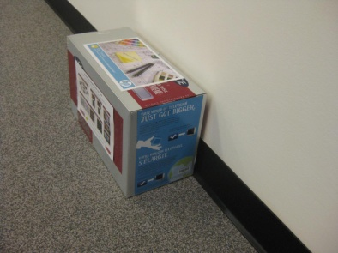
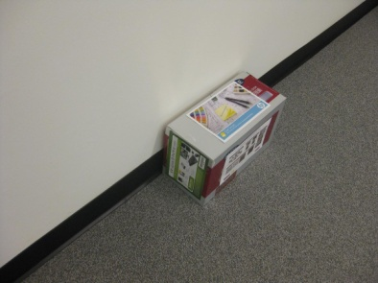
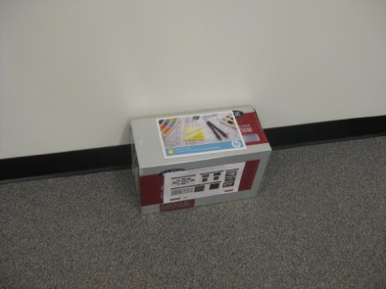
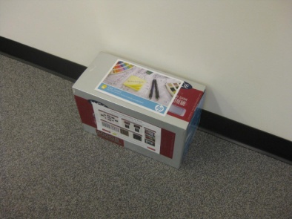
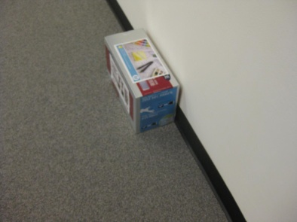
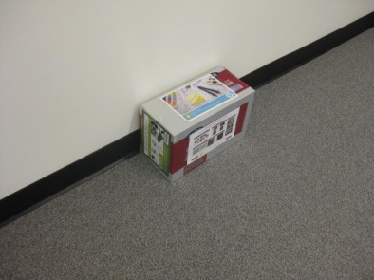
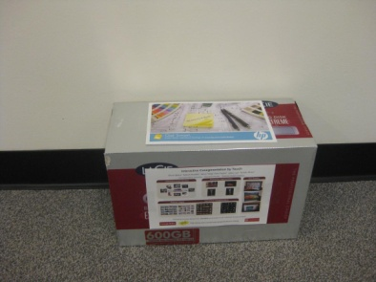
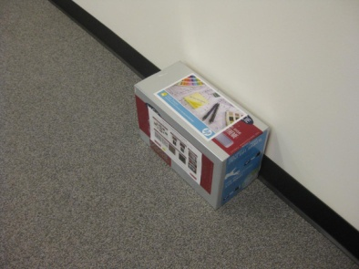
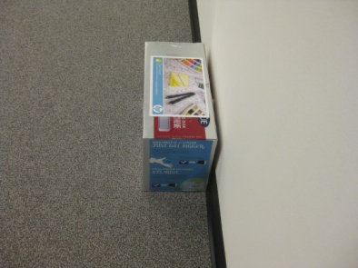
i3D: Interactive planar reconstruction

Slide 3
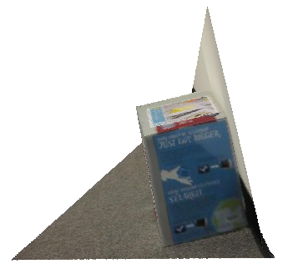
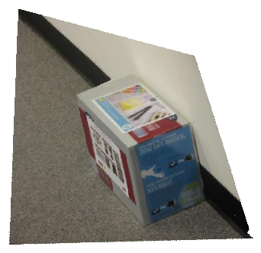
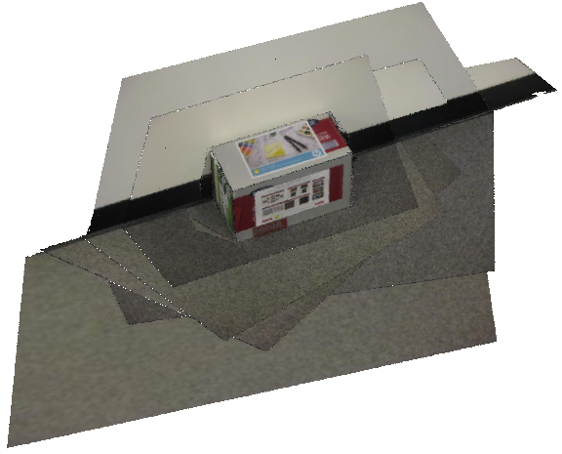
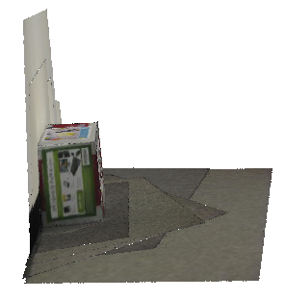
i3D: Interactive planar reconstruction

Slide 4
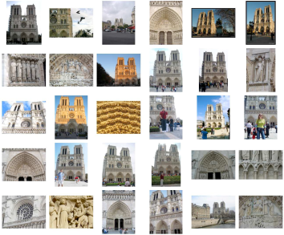
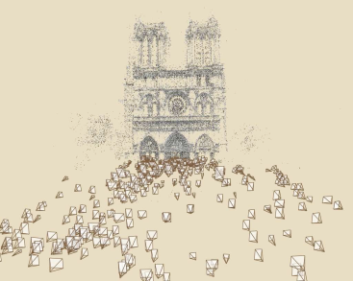
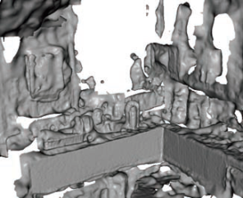
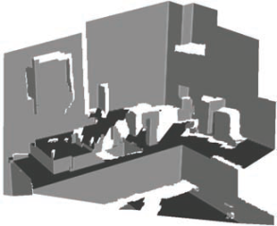
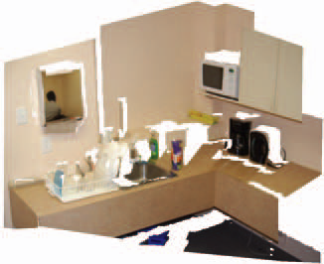
Introduction to i3D
Automatic 3D reconstruction algorithms
Furukawa et. al., CVPR ‘07
Snavely et. al., SIGGRAPH ‘06
Furukawa et. al., CVPR ‘09
Sinha et. al., ICCV ‘09

Slide 5
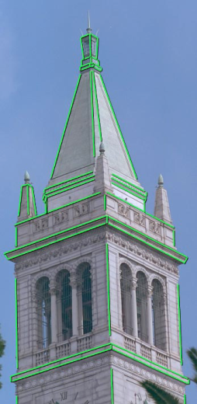
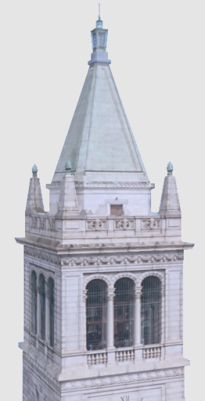
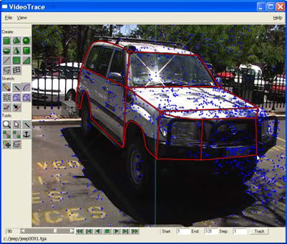
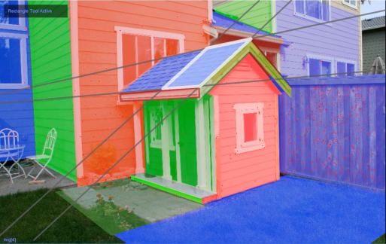
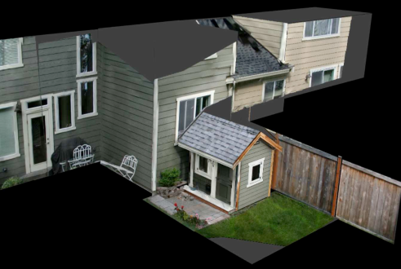
Introduction to i3D
Interactive 3D reconstruction algorithms
Debevec et. al., SIGGRAPH ‘96
Hengel et. al., VideoTrace
SIGGRAPH ‘07
Sinha et. al., SIGASIA ‘08

Slide 6
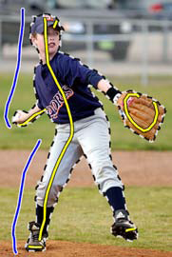
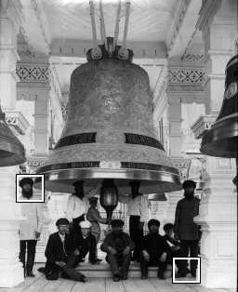
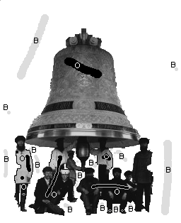
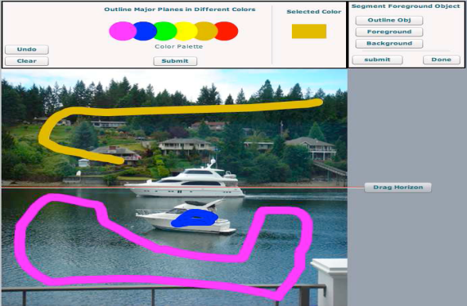
Introduction to i3D
Scribbles as a form of interaction
Boykov and Jolly, ICCV ’01.
Li et al. Lazy Snapping. SIGGRAPH ’04.
Improvement to Make3D (3D from a single image)
Srivatsava et. al., VMV ‘09

Slide 7
Algorithm

Slide 8
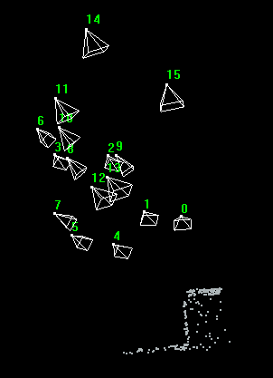
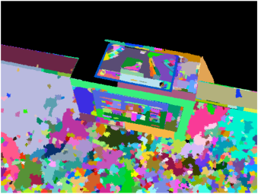
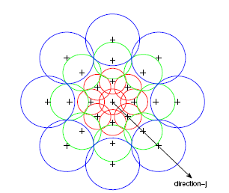
Preprocessing
Structure from motion
Superpixel map – mean shift
SIFT-like daisy descriptor
Notes:
SFM:
Recover camera pose
Sparse 3D points
Feature point correspondence across views
SIFT-like daisy descriptor computation
200 dimensional vector
Gradient orientation from 3 radial directions and 8 angular directions binned into 8 bins

Slide 9
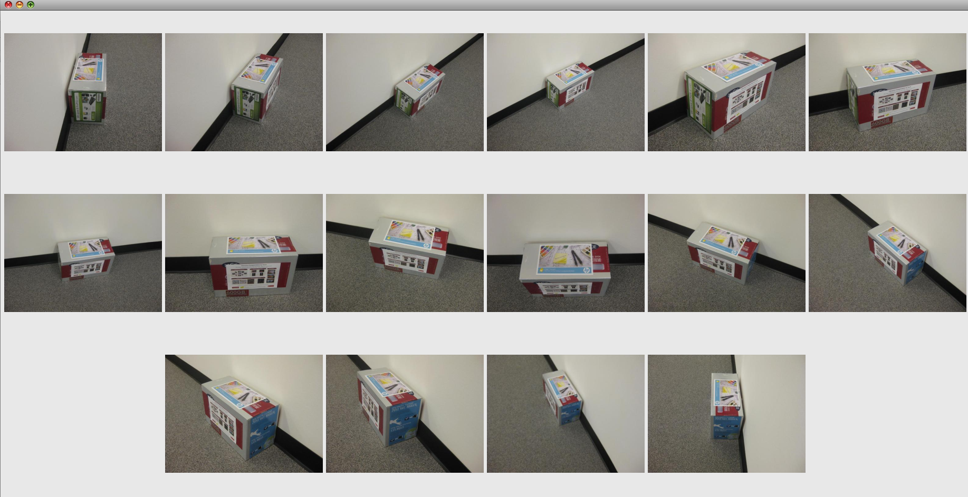
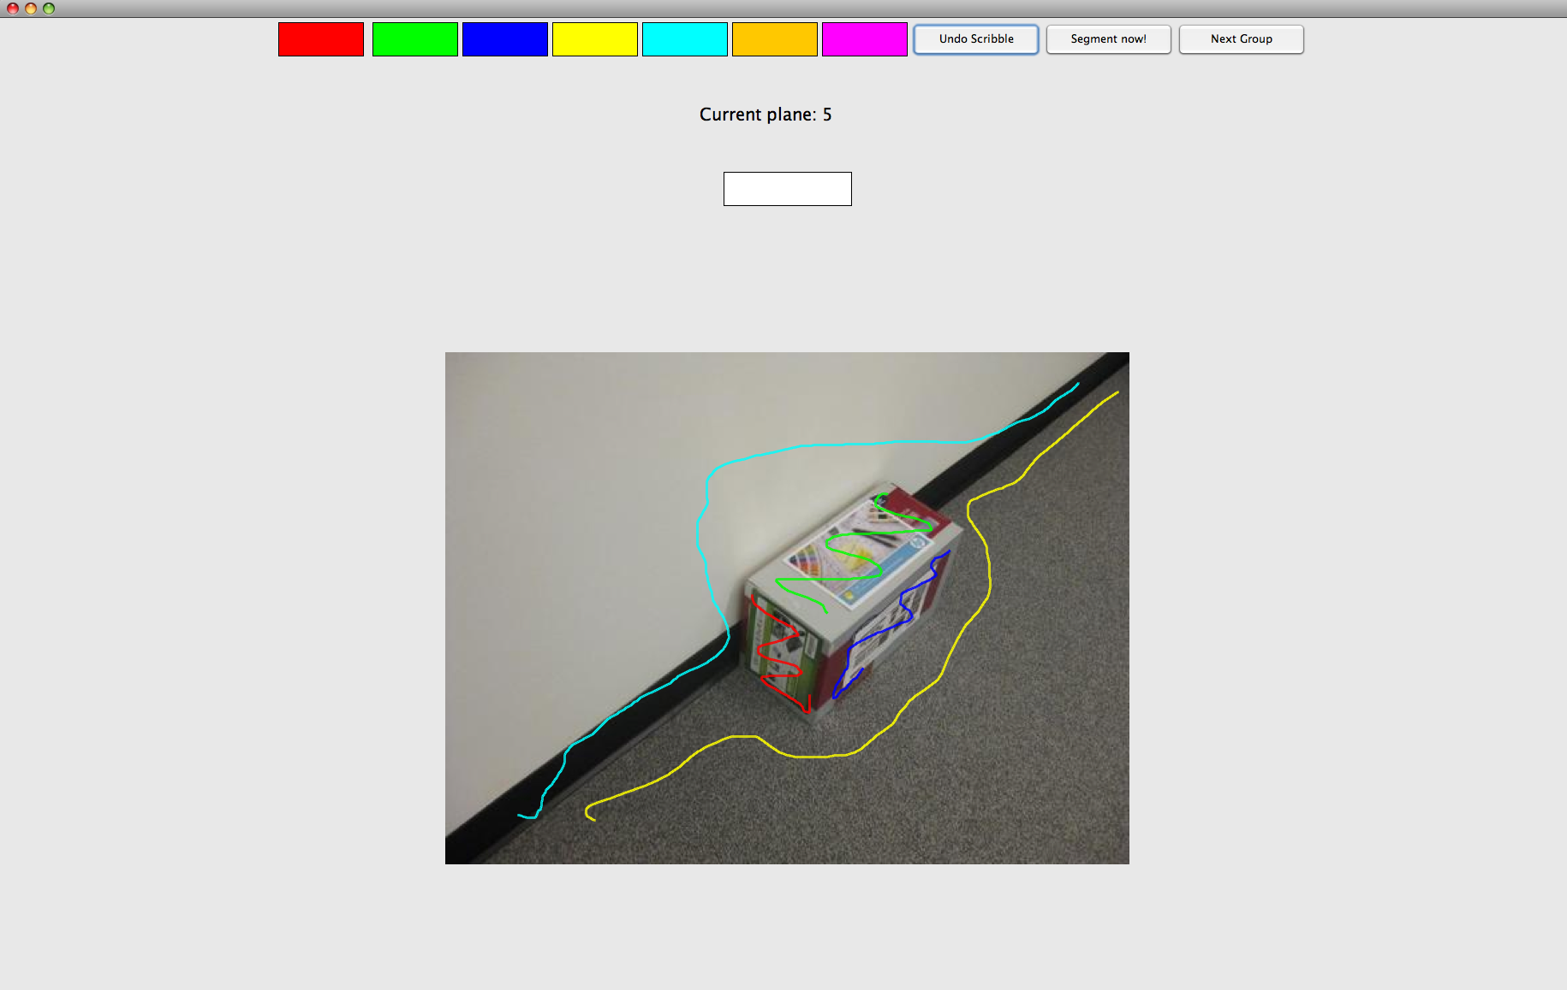
Interactions

Slide 10
Segmentation
What do we do the scribbles?
One-against-all classifier – Logistic regression
Feature vector – mean daisy descriptor of pixels in each labeled superpixel
Test each image – obtain response for each class
Maintain smoothness in segmentation – energy minimization problem
Node energy
Edge energy

Slide 11
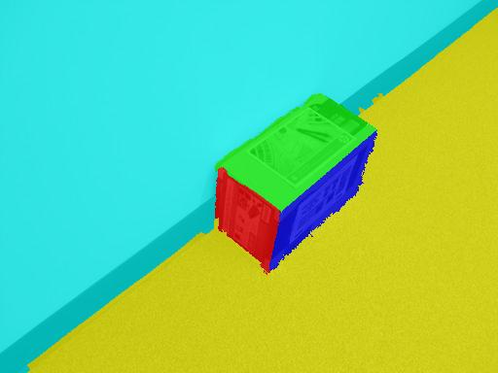
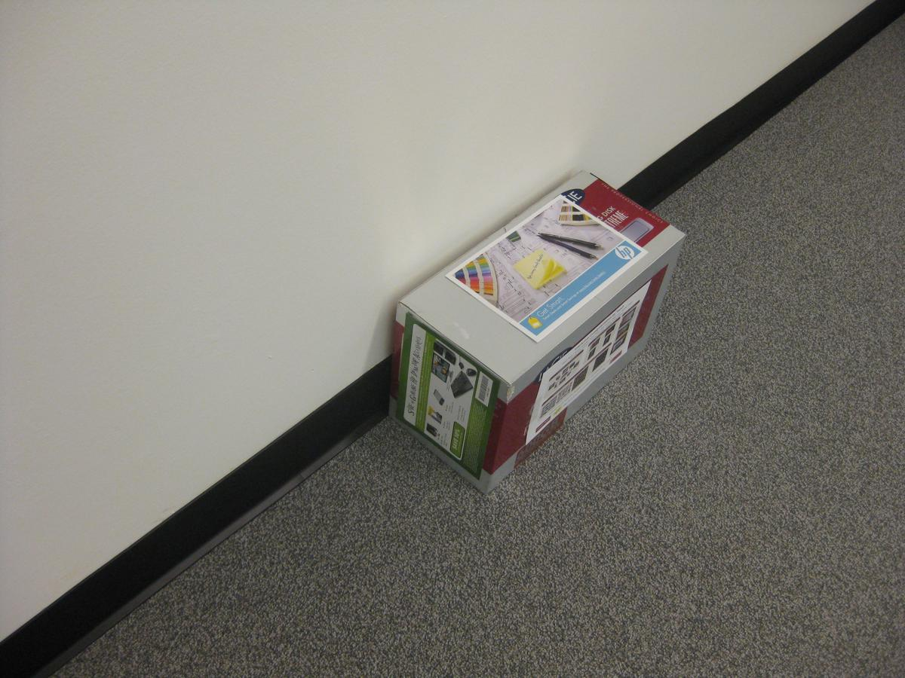
Segmentation

Slide 12
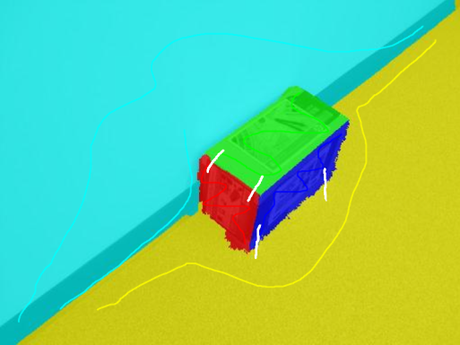
Plane co-segmentation
Transfer labels to 3D point cloud
Provide edge connectedness to help estimate a globally accurate plane
Estimate plane parameters – RANSAC
Estimate homography for each plane from scribbled image to other images
Warp these segments
Also an energy minimization problem

Slide 13
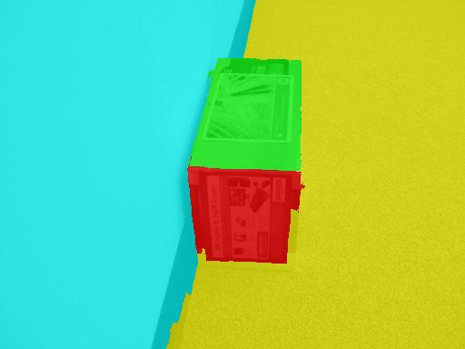
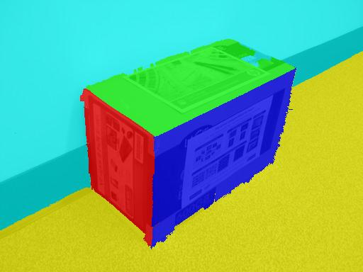
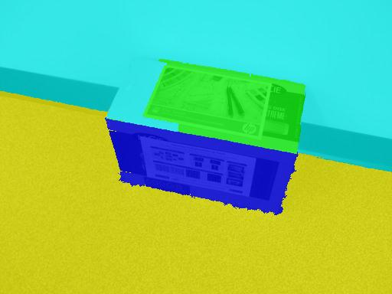
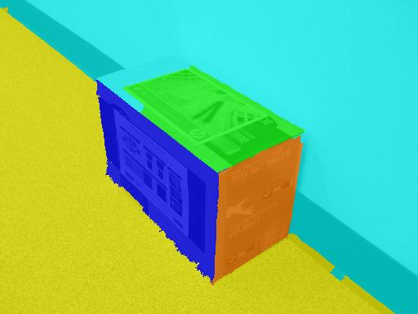
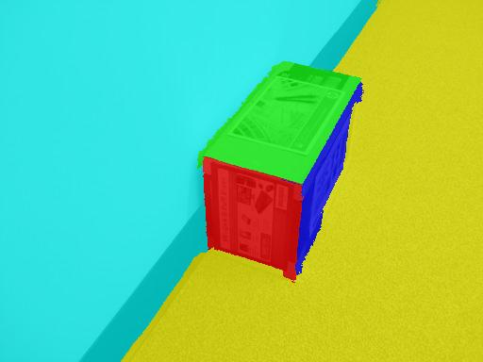
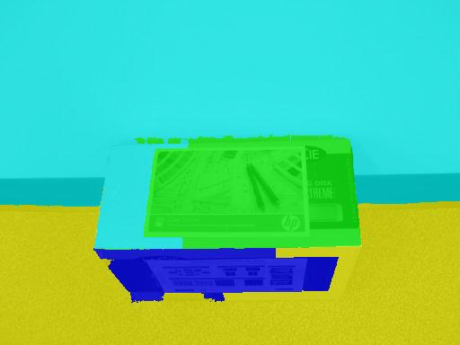
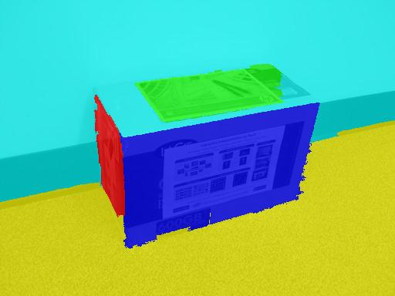
Plane co-segmentation

Slide 14
Closing the loop
3D Model
Notes:
Convert to a loop of images

Slide 15
Visualizations

Slide 16
Texture synthesis and rendering
Texture preprocessing – segmentation refinement #
View selection*
Incrementally build the model
Visualizations
Dense point cloud
Mesh visualization
*Debevec et. al., SIGGRAPH ’96
#Details in the paper

Slide 17
Segmentation refinement

Slide 18
Segmentation refinement

Slide 19
Dense point cloud with texture
Perform view selection and incrementally build the model
Use camera projection matrix and back-project each pixel onto the corresponding plane

Slide 20
Mesh visualization
Modeling the 3D geometry using triangular meshes
Single mesh model – Single image texture
Multiple mesh model

Slide 21
i3D: Interactive planar reconstruction
More results…

Slide 22
i3D: Interactive planar reconstruction
More results…

Slide 23
Conclusion
i3D, a new interactive planar 3D reconstruction algorithm using simple user interactions in the form of scribbles
Discuss multiple methods to refine segmentations and correct superpixel leaks
Complete and pleasing reconstructions – described two forms of visualizations

Slide 24
Thank You

Slide 26
i3D: Interactive planar reconstruction
More results…

Slide 27
i3D: Interactive planar reconstruction
More results…

Slide 28
Closing the loop
User provides scribbles on any image
Perform segmentation of the image using the daisy descriptors
Provide edge connectedness scribbles
Estimate plane parameters
Perform plane co-segmentation
Loop – Control with the user
Notes:
Convert to a loop of images

Slide 29
View selection
Rank images based on angle between the plane normal and viewing direction – lower the angle better the view
Incrementally build the model*
Start with the best view for each plane – will have holes due to occlusion
Proceed with the next one in order of ranking and incrementally fill up the holes
*Debevec et. al., SIGGRAPH ‘96

Slide 30
Segmentation refinement
Stage 1:
Warp segments from each image to every other image
For each image refine the segmentations of each plane by taking a per-pixel vote of all the warps
Stage 2: (mainly for scenes with polygon boundaries)
Use the line of intersection of every pair of planes
Project this line in 3D onto images
Use line to define plane boundary

Slide 31
3D Visualization
Visualization chosen based on application
Full model required
Dense point cloud with texture
Multiple mesh model
Pleasing visualization – fly through
Single mesh model

